Slide 1
Operational Readiness – CDI Data Platform
Sep 2025

Slide 2
Agenda
03
Support Coverage
04
In Scope Activities
07
Out Of Scope Activities
08
Our Proposed Approach
09
Communication Channels
10
Service Levels

Slide 3

Support Coverage
Functions | Baseline Scope
Services | Defined in-scope services
Language | English
Support Hours | 8*5 (India shift)
Business support Window | Monday to Friday
Monitoring tools | Azure and Databricks monitoring tools

Slide 4

Proposed Approach
1
2
3
Monitoring and Reporting
Service Delivery
Service Review
  Monitoring & Reporting
  Monitoring of batch jobs & background processes.
  Raise incidents / tickets upon identification of issues.
  Communication and Reporting on failures & resolutions.
  Plan to avoid repeated failures.
  Monitor incident / ticket queue and follow incident management process.
  Investigate incidents & provide resolution.
  Work with third party where needed to implement resolution.
  Support requests for Adhoc, historical data loads.
  We will conduct monthly service reviews with the following metrics reports:
    Total numbers of issues (as a control measure)
    Breakdown of problems at each stage (e.g. logged, work in progress, closed etc.)
    Size of current problem backlog
    Service Improvement
    Feedback

Slide 5


Indicative - In Scope Activities - Protiviti
Activities
Monitoring & Operations
Proactively monitor Azure Data Factory pipelines for job schedules
Ensure smooth automation workflows through Logic App monitoring
Monitor Azure components within the hub environment for optimal performance
Keep a close watch on Databricks performance
Catch and dispatch auto-alert tickets to the appropriate next-level support groups
Incident & Issue Management
Identify and address application errors to maintain system stability
Handle retrigger and resubmission of failed pipelines to minimise disruptions
Governance, Reporting & Continuous Improvement
Manage necessary configuration changes, such as Key Vault modifications
Prepare and share Monthly Service Reports
Conduct periodic assessment of infra for capacity management
Maintain and refine auto-alerting configurations

Slide 6
Indicative - In Scope Activities - Protiviti
Activities
Investigate basic queries
The required unit cannot be found in the data.
The unit details are either incorrect or missing entirely.
There are issues or clarifications needed regarding MDS queries- Drop the file, run the process, confirm once loaded/failed
The budget information requires clarification or has discrepancies- Drop the file, run the process, confirm once loaded/failed
Users are facing problems related to system or data access.
Data Defects
Certain expected data values are missing from the dataset.
Data does not match R&A, MyMicros, or other source systems.
PBI Development or Defects
Users are experiencing navigation issues inside the Power BI dashboard.
Some parts of the dashboard are broken or not functioning.
The user guides within the dashboard need updating.
The dashboard is performing too slowly or facing performance issues.

Slide 7


In Scope Activities – CDI Team
Activities
Drive Cost management initiatives for optimised cloud spending
Ensure seamless Data Accessibility across all regions
Provide comprehensive Power BI Platform Management
Manage user access rights decisions and approvals
Oversee Data Ownership responsibilities and governance
Facilitate the Creation of spoke environments as needed
Offer data security recommendations and management

Slide 8
In Scope Activities - ISO
Activities
Manage the cloud subscription for SSP
Maintain the Shared Integration Runtime environment
Implement and oversee Security configurations
Handle User access administration tasks.
Provide Support for the Creation of Spoke environments

Slide 9

Out of Scope Activities
Activities
The required source data is not available or accessible for processing. Data ownership or corrections must be handled within the source systems. Changes or enhancements are required in third-party applications or APIs. New development activities are requested or currently in progress. Users have requested new KPIs or additional report development. The issue or request relates to other connected dashboards.

Slide 10
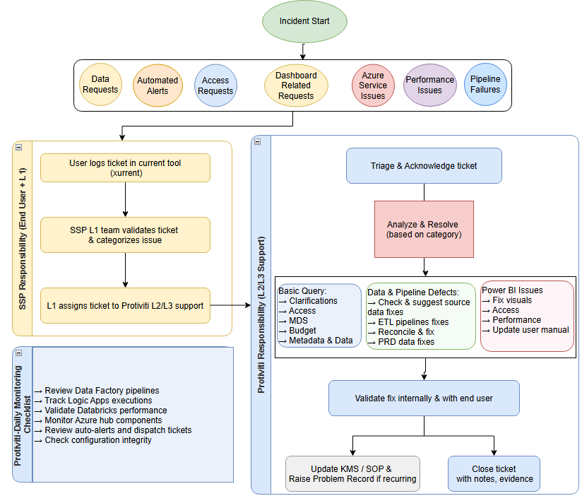
Support Approach

Slide 11
Service Desk Reporting
We provide reporting on a Monthly/Quarterly/Annual basis.
Samples metrics include the following (Can be updated during transition phase):
  Call Volume by Hour/Day of Week
  Talk Time & Average Talk Time
  Hold Time & Average Hold Time
  Number of Abandoned Calls and Abandonment Rate Percentage
  Volume by Category/Type
  Volume by Priority (P1, P2, P3)
  Time to Resolve and Average Time to Resolve (can also be measured by Priority)
  Additional reports can be agreed as we mature in support stage

Slide 12
Communication Channels
These communication channels are designed to meet the demands of the support service in an effective manner
Communication Schedule | Urgent Communication | Regular Communication | Escalation
Protiviti will schedule a service delivery review each month. | Protiviti will create a group email to notify everyone in the support team about an urgent issue. | Any regular communication should ideally happen via the ticketing system | In unusual circumstances if SSP desires to escalate an issue with the service, you can reach out to our escalation contacts.
Objective: Review service performance and identify improvements. Agenda: Metrics, feedback, challenges, action plan. | EMAIL id <CDIPlatform.support@protivitiglobal.in> | SSP Ticketing system - Xurrent | First Escalation Point: <TBD>. Highest Escalation Point: Nikunj Chadha

Slide 13
Priority of Incidents – Definition
P1 - Urgent
P2 - High
P3 - Medium
P4 - Low
A critical error that causes total failure of the application or a major problem with a specific functional area of the system or modules cannot be used until the defect(s) are rectified.
A functionality that does not work as defined and no practical workaround is available
Performance testing for the specified concurrent users was unsuccessful
Response time was not met for the specified concurrent users
The application/system is not accessible by Staff
Serious errors. One of the application/ module is not accessible by Staff
A functionality that does not work as defined, but a practical workaround is available.
Workaround can be handled with the existing staffing and increases the execution time
Medium errors. These do not prevent the acceptance by users
One of the application/ module is not functioning properly
Incidents that are causing a minor defect in the application, but which may not cause test scripts to fail.
GUI type of changes/ does not include any enhancement
Incidents which are non-critical and not holding the Business process
Minor changes in the application related to existing queries within the application

Slide 14
Service Levels – Response/Resolution Time
P1 - Urgent
P2 - High
P3 - Medium
P4 - Low
Response Time
Within 15 min
Within 2 hours
Withing 4 hours
Within 1 Business day
Resolution Time
Within 2 hours
Within 4 hours
Within 1 Business day
Within 5 Business days

